Slide 1







Current and Future Technology Trends
Leslie Dailey
February 2022

Slide 2



OUTLINE
Executive Summary
Introduction
Methodology
Results
Visualization – Charts
Dashboard
Discussion
Findings & Implications
Conclusion
Appendix

Slide 3

EXECUTIVE SUMMARY
Data Analysis based on “The 2019 Stack Overflow Developer Survey Results”
Present and future trends for programming languages and databases.
Interactive Dashboard of survey
Large gender gap in tech industry

Slide 4

INTRODUCTION
Purpose: Analyze developer trends across all industries to better prepare organizations for the future
Intended audience: Human Resources, Developers, Managers in the tech industry

Slide 5

METHODOLOGY
Data sources:
GitHub job postings
Programming languages annual salary
Stack Overflow 2019 Developer Survey
Exploratory data analysis
Data wrangling
Data visualization
Matplotlib
IBM Cognos
Share the findings

Slide 6
RESULTS
Trends between programming languages & databases
Interactive dashboard with 3 tabs
Current Technology Usage Trends
Future Technology Trends
Demographics of Developers

Slide 7
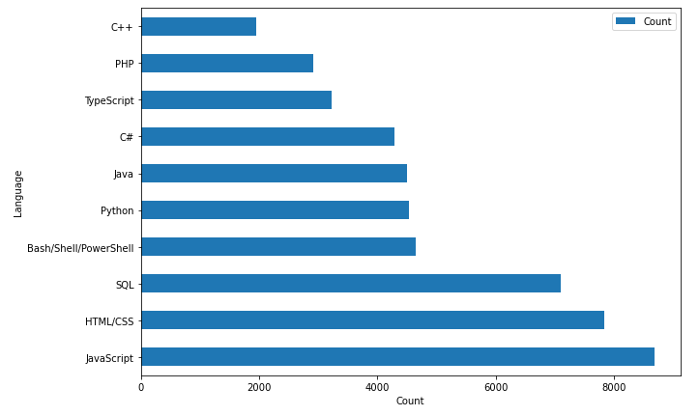
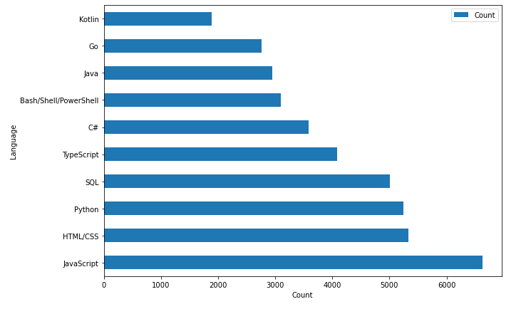
PROGRAMMING LANGUAGE TRENDS
Current Year
Next Year

Slide 8
PROGRAMMING LANGUAGE TRENDS - FINDINGS & IMPLICATIONS
Findings
Typescript gained the most popularity in a single year
Bash/Shell/PowerShell went down in ranking the most
JavaScript and HTML/CSS still rank the highest out of all languages
Implications
JavaScript and HTML/CSS reman as high demand skills for developers
Bash/Shell/PowerShell went down by 3 ranks, this could be cause to upskill employees if this continues
Typescript or Python could be good options for organizations to upskill to since they moved up in rank the most

Slide 9
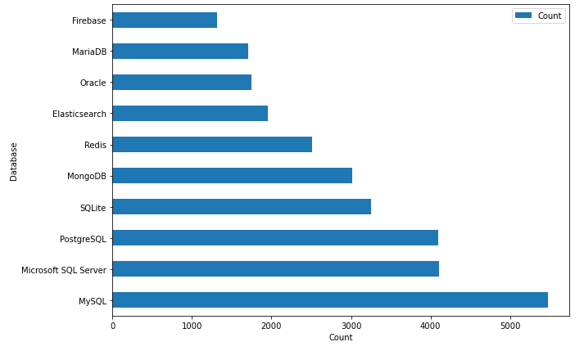
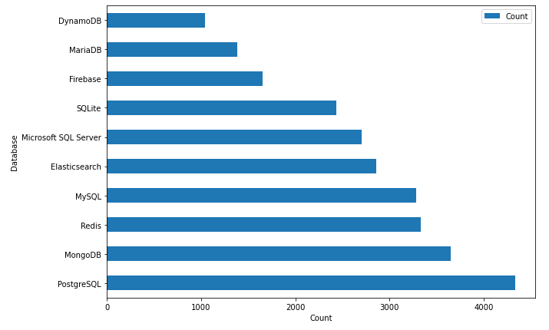
DATABASE TRENDS
Current Year
Next Year

Slide 10
DATABASE TRENDS - FINDINGS & IMPLICATIONS
Findings
Much larger changes on the database side compared to languages
Microsoft SQL Server moved down 4 ranks
Redis & MongoDB both moved up 3 ranks
Implications
Database preference doesn’t have a clear winner with every type moving up or down
Clear that open data source databases are here to stay
With so much change in preference it’s hard to match organizations with developers that have solid skills in one database

Slide 11

DASHBOARD
https://dataplatform.cloud.ibm.com/dashboards/71e3754d-a01e-4ca8-8f86-faf2293c5b4e/view/4e60fb1b24eb16925fcec4e407cf2b532937740ce0bbd157d5827b495c667297a96c1594c8284e0989475731f2eb1b5f9d

Slide 12
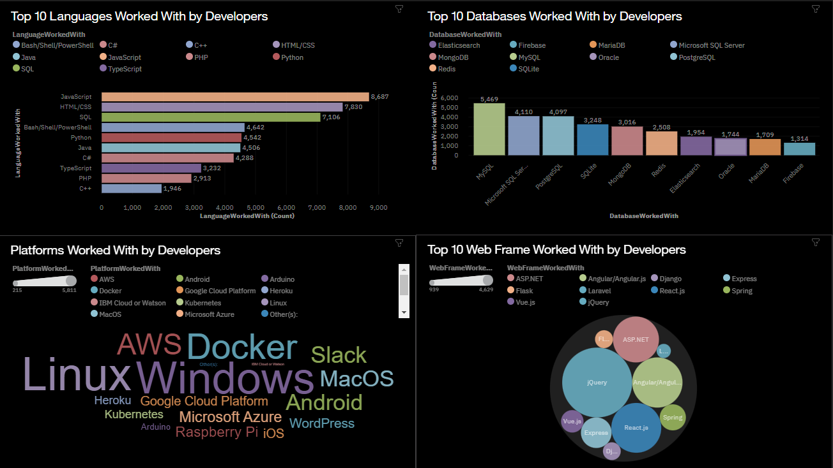
CURRENT TECHNOLOGY USAGE DASHBOARD

Slide 13
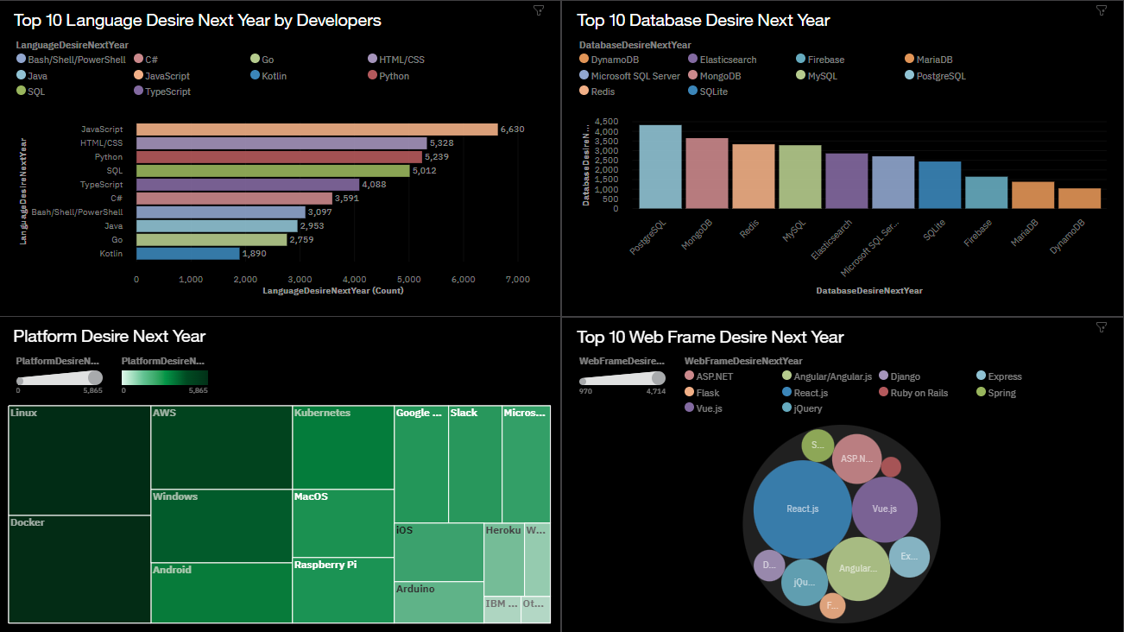
Future Technology Trend Dashboard

Slide 14
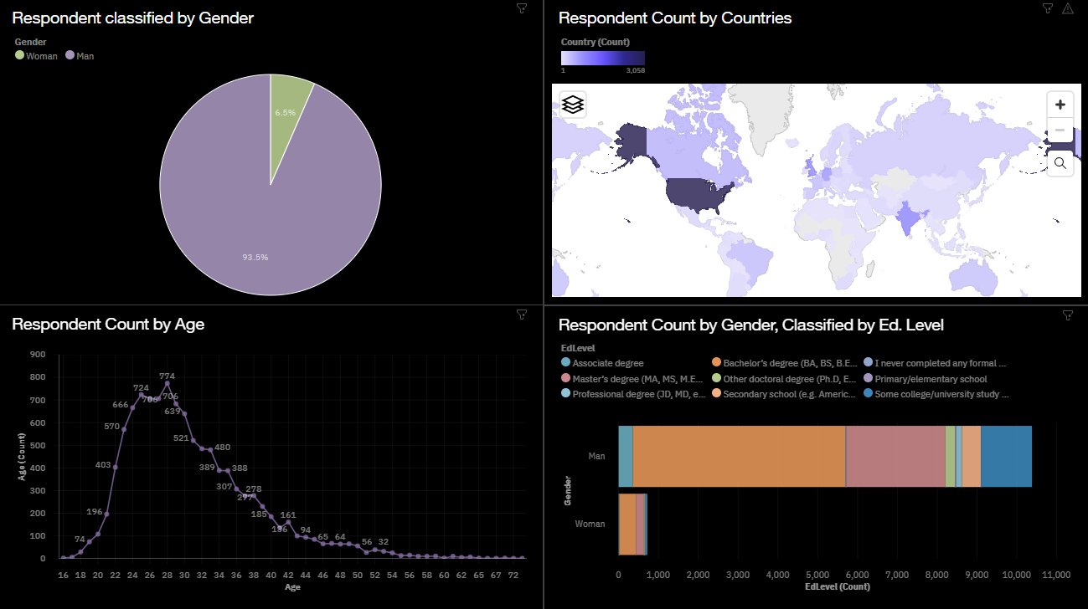
DEMOGRAPHICS DASHBOARD

Slide 15
DISCUSSION
Gender gap in industry
Age inequality
Upskilling options

Slide 16
OVERALL FINDINGS & IMPLICATIONS
Findings
Clear age inequality
Large gender gap in industry
USA is leading in the tech industry
HTML and Java are essential for most developers and no clear winner for databases
Implications
Older developers could be the missing key in an organization’s problems
Women could be a valuable asset on ai projects to account for bias
Databases fluctuations make it difficult for organizations to match their needs with developers.

Slide 17

CONCLUSION
Present and future trends in IT
Demographic issues seen in the industry
Interactive dashboard available for additional exploration
Organizations need to stay flexible with technology in order to stay competitive

Slide 18

APPENDIX

Slide 19
GITHUB JOB POSTINGS

Slide 20
POPULAR LANGUAGES

Slide 21
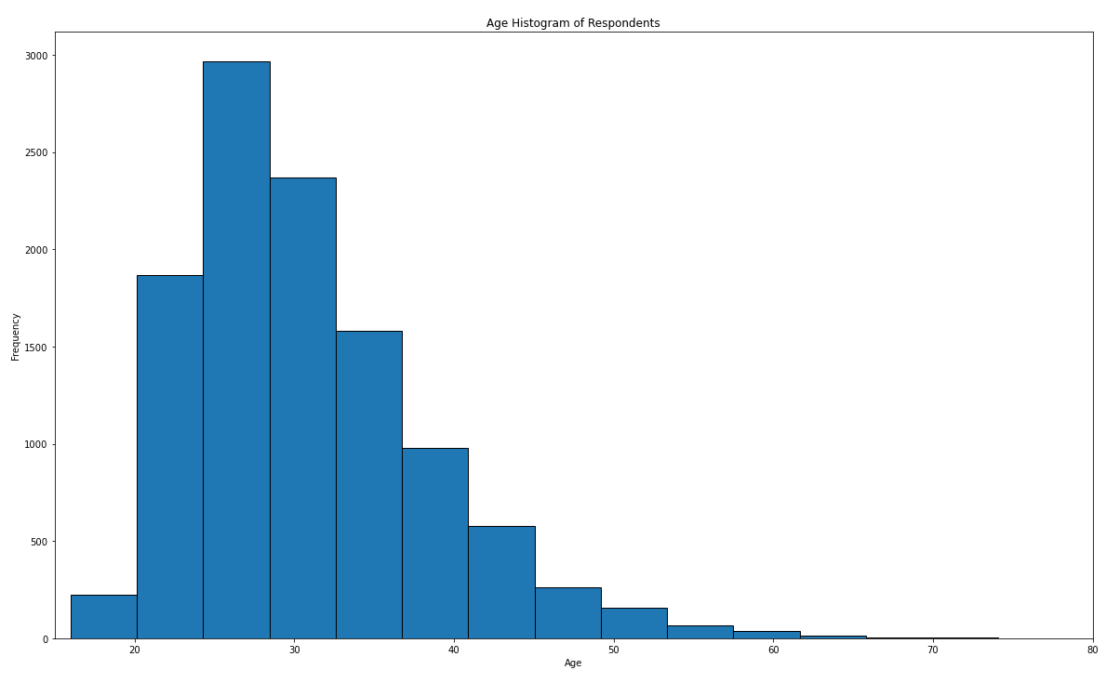
AGE OF RESPONDENTS

Slide 22
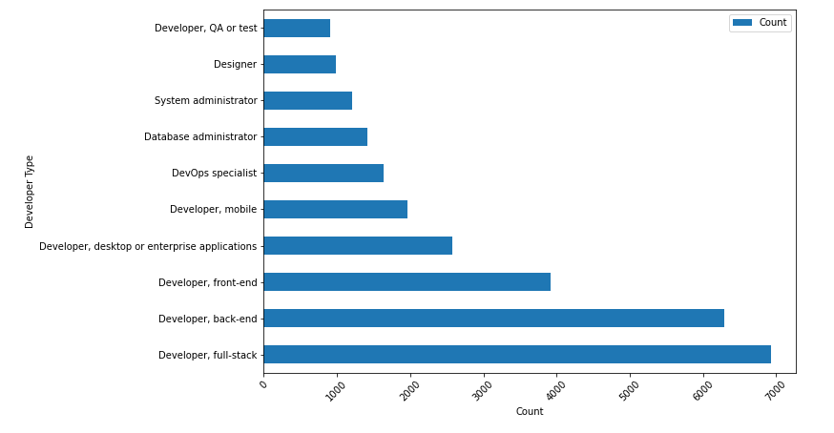
TYPES OF DEVELOPERS

